Slide 1
EE-463 Static Power Conversion – 1
Term Project Feedback Session
Civan Serhat Çevik
Yusuf Toprak Yıldıran
Batuhan Elmas

Slide 2
Outline
1- Topology Selection
2- Simulation Results
3- Component Selection

Slide 3
1- Topology Selection
Three Phase Full Bridge Diode Rectifier
High Average Output Voltage
Relatively Lower Ripple Voltage
Elimination of Third Multiple of Harmonics
Buck Converter
Efficiency
Simple to Implement
Low Side Switching

Slide 4
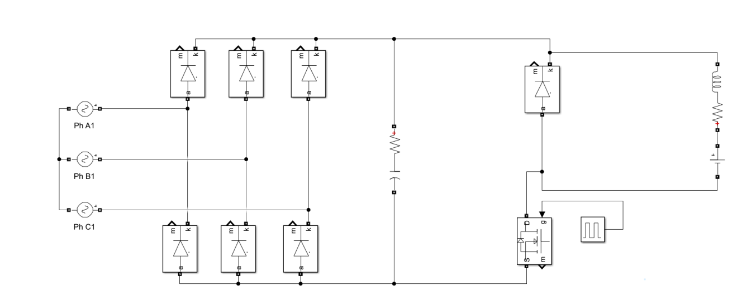
2- Simulations

Slide 5

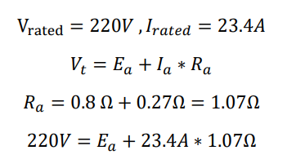

2- Simulations
Ideal diodes and switch , D=0.8
Rated motor conditions
Modelling DC motor parameters:
Armature + Interpole
Armature + Interpole
Back EMF

Slide 6
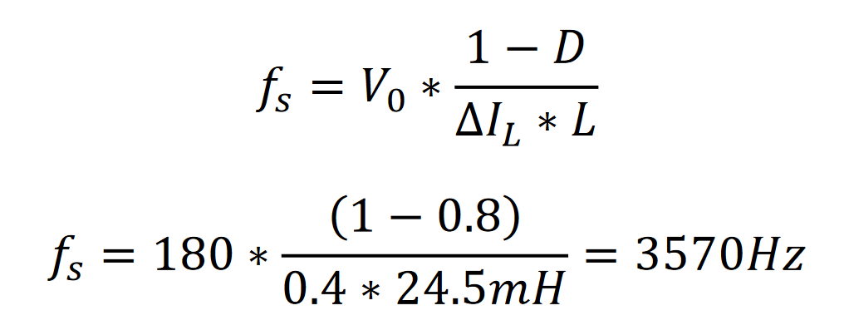

2- Simulations
Buck Converter Switching Frequency
Expected Output Current: $2.5 kW=180V ∗14 A$
Desired Current Ripple: 3% $14 ∗0.03=0.4A$

Slide 7
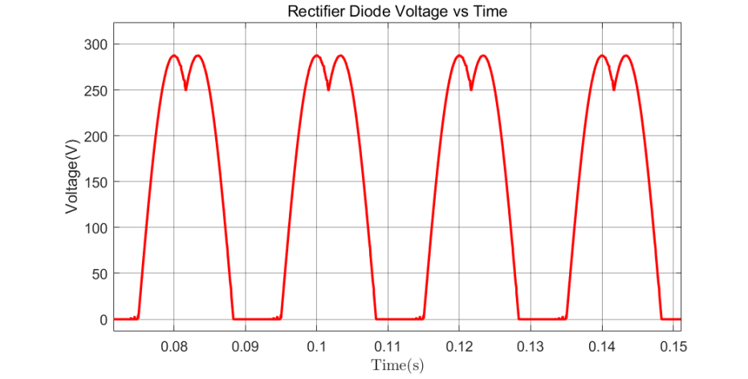
2- Simulations
a) Rectifier Diodes Voltage - Vmax=300V

Slide 8
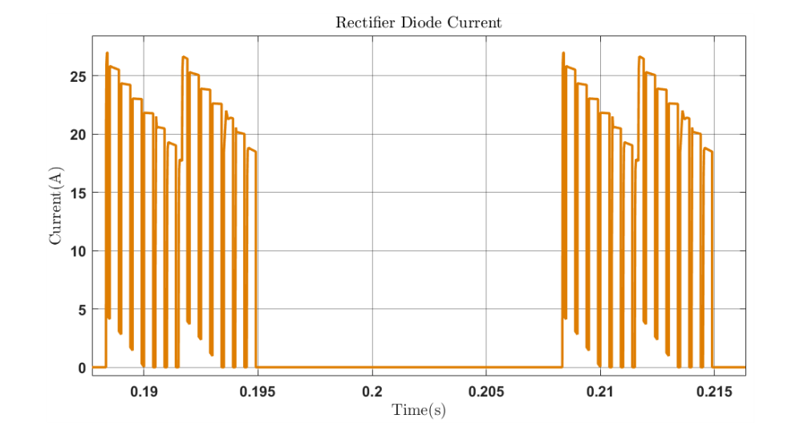
2- Simulations
a) Rectifier Diodes Current - Imax=26A

Slide 9
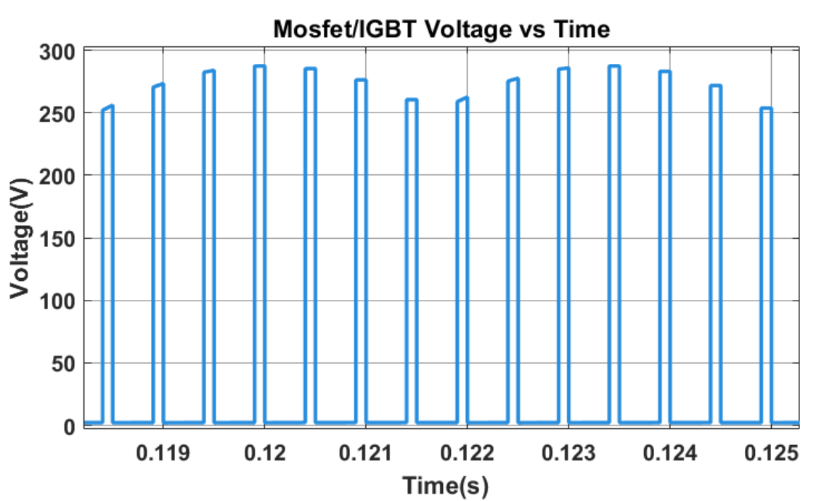
2- Simulations
b) Buck Converter Switch Voltage- Vmax=300V

Slide 10
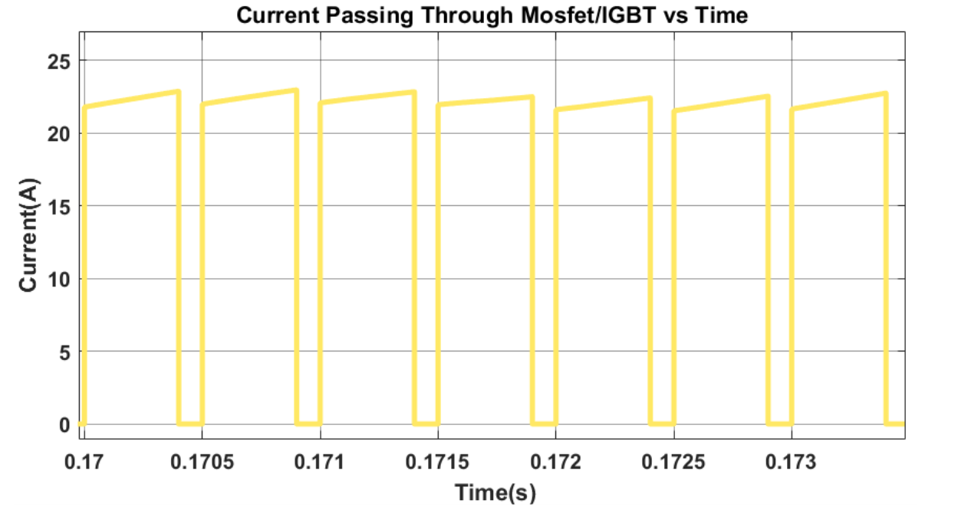
2- Simulations
b) Buck Converter Switch Current- Imax=25A

Slide 11
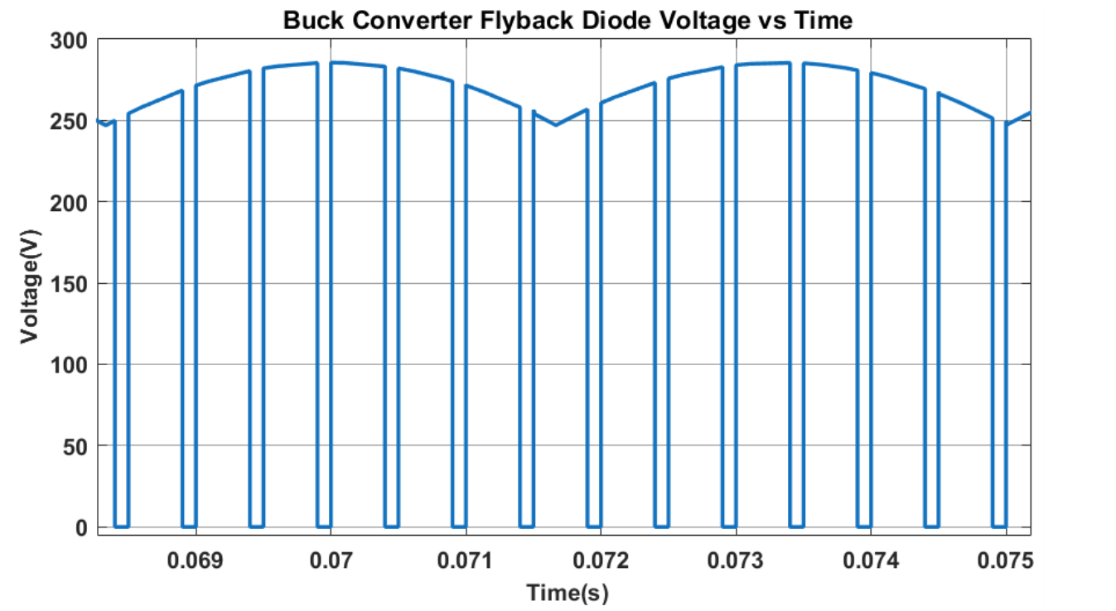
2- Simulations
c) Buck Converter Freewheeling Diode Voltage - Vmax=300V

Slide 12
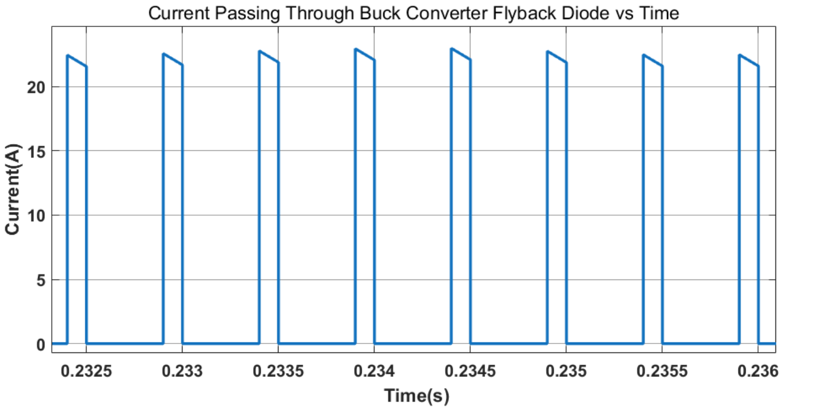
2- Simulations
c) Buck Converter Freewheeling Diode Current- Imax=23A

Slide 13
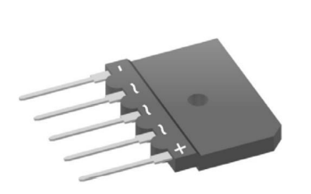
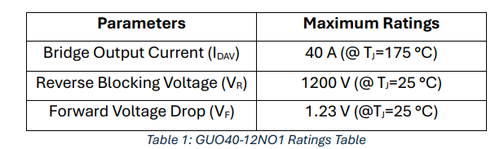
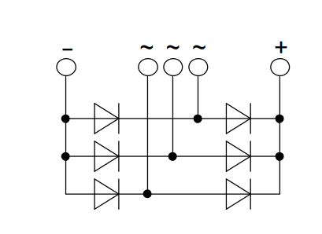
3- Component Selection
a) Rectifier Diodes - GUO4012NO1
Single module rectifier
Simple to implement-THT
Cooling is more important!

Slide 14
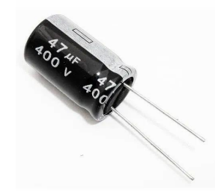
3- Component Selection
b) Rectifier DC-Link Capacitor
Electrolytic Capacitor
400 V – 47 µF
Parallel Connection, Lower ESR

Slide 15
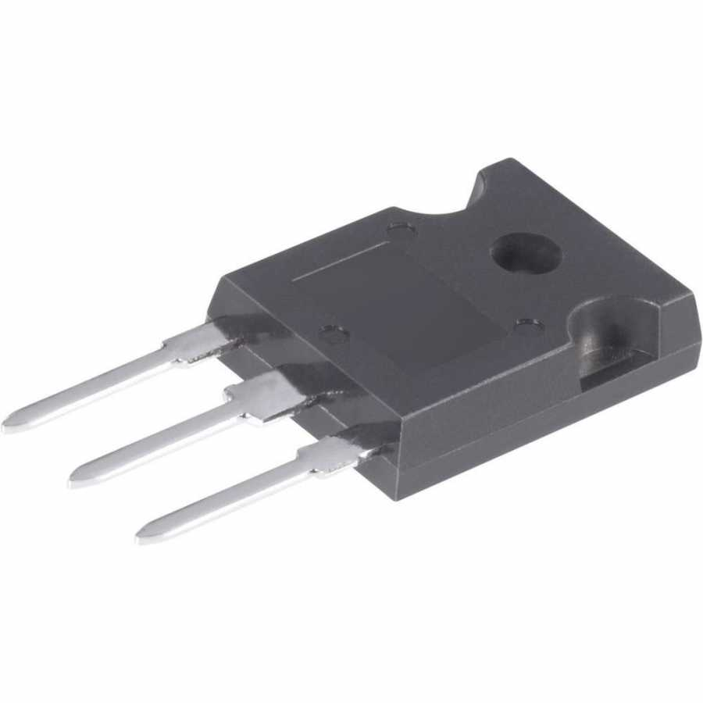
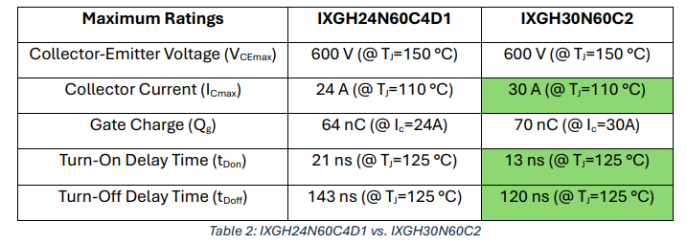
3- Component Selection
c) Buck Converter Switch - IXGH30N60C2
High voltage ratings
Switching frequency is not very high (3kHz)
IGBT is suitable

Slide 16
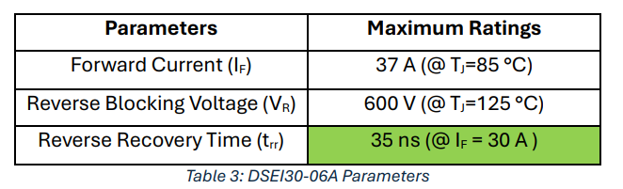
3- Component Selection
d) Buck Converter Freewheeling Diode - DSEI3006A
Fast Recovery, suitable for our frequency range
Can withstand the values up to 37A and 600V

Slide 17

3- Component Selection
e) Gate Driver
Timer IC: TL494, Astable operation,
Internal 5V Reference Voltage
Optocoupler for isolation: TLP250

